Slide 1
Data Science
UNIT-V
Prescriptive Analysis
Dr. N. Subhash Chandra
Professor CSE

Slide 2
UNIT-1: Contents
UNIT V – Prescriptive Analysis
Forecasting Techniques: Time series data, Techniques, and accuracy, Moving average method, Single, double, triple exponential smoothing, Regression model for forecasting, Auto-Regression models, ARIMA Process.
Graph Analytics: Path analysis, Connectivity analysis, Community analysis, Centrality analysis, Social-Network Graphs, Communities and Clusters, Betweenness, The Girvan-Newman Algorithm.

Slide 3
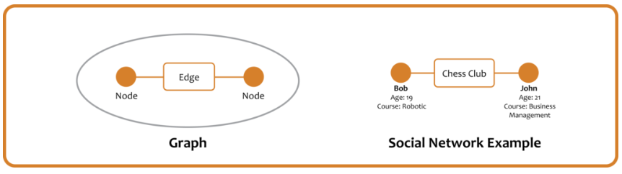
Graph Analytics
Graph analytics, also known as graph algorithms or network analysis, is the analysis of data in a graph format using data points as nodes and relationships as edges.
Nodes signify points or entities Every node and edge hold specific properties that define its characteristics.
Graph analytics is used to determine the strength and the direction of connections between objects in a graph.
Graph analytics enables you to store, manage, and query data in the form of a graph. It allows you to find the relationships between people, places, things, events, locations, and others.

Slide 4
Graph Analytics
Graph analytics tends to provide a pairwise relationship between the objects and represent the structural characteristics of a graph.
Graphs are visually appealing and make it easier to understand how complex networks behave.
The best part about graph analytics is the ease with which you can add information to a graph. It is not necessary to understand everything about your data to start storage and investigation.
Some of the most popular tools for graph analytics include Neo4j, OrientDB, Amazon Neptune, and several others.

Slide 5
Types of Graph Analytics
Graph analytics can be categorized into four main types. Let’s have a quick look at them.
1. Path analysis
Path analysis tends to focus on the relationships between two nodes in a graph. It determines the shortest distance between two nodes and analyzes similar shapes and distances from different paths that connect entities within the graph.
2. Connectivity analysis
Connectivity analysis is used to determine the strength of two interconnected nodes. It helps you identify whether the connection between the nodes is strong or weak. Connectivity analysis also determines the number of edges flowing into the node and the ones flowing out of the node.
3. Centrality analysis
It tends to determine the importance of a present node within the graph network and its connectivity to others. Centrality analysis enables you to understand the most influential node and the connection it accesses.
4. Community Analysis (Network analysis)
Network analysis, also known as, community analysis tends to define the density of relationships between nodes. It helps you learn about the nodes that frequently interact with each other in a graph network. Network analysis also enables you to determine if the connecting edges are transient. It tends to predict whether the created graph network will grow or not.

Slide 6
What is a Social Network?
Social networks are websites and apps that allow users and organizations to connect, communicate, share information and form relationships.
Ex: Facebook, Twitter, Google+, or another website that is called a “social network,” and indeed this kind of network is representative of the broader class of networks called “social.”
The essential characteristics of a social network are:
There is a collection of entities that participate in the network. Typically, these entities are people, but they could be something else entirely.
There is at least one relationship between entities of the network. On Facebook or its ilk, this relationship is called friends. Sometimes the relationship is all-or-nothing; two people are either friends or they are not.
There is an assumption of non randomness or locality. This condition is the hardest to formalize, but the intuition is that relationships tend to cluster. That is, if entity A is related to both B and C, then there is a higher probability than average that B and C are related.

Slide 7
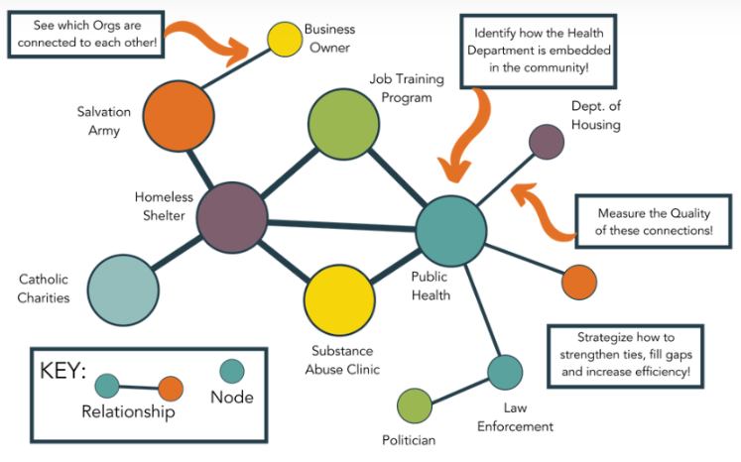

Slide 8
1. Nodes (or Vertices)
These are the individual entities within the network, which could be people, groups, or other organizations. They are the basic unit of analysis in a social network. For example, in a friendship network, each person would be a node.
2. Edges (or Links or Ties)
These represent relationships or interactions between nodes. For instance, an edge may represent a friendship between two people or a business transaction between two companies.
3. Degree
This is the number of connections a node has. A person with a high degree in a social network could be considered popular or influential as they have many connections to others.
4. Density
A measure of how many connections exist in the network compared to how many could possibly exist. High density networks suggest that many members are connected to each other, promoting quick information or disease spread.
5. Degree Centrality
This quantifies the importance of a node within the network. Nodes with high centrality are influential within the network due to their connections.
6. Betweenness Centrality
This is a type of centrality that quantifies the number of times a node acts as a bridge along the shortest path between two other nodes. It identifies nodes that connect different parts of a network.

Slide 9
7. Closeness Centrality
Another type of centrality that measures how close a node is to all other nodes in the network. Nodes with high closeness centrality can quickly interact with all others.
9. Clusters (or Communities)
These are groups of nodes that have a higher density of ties among themselves than with nodes outside the group. For instance, groups of friends within a larger social network.
12. Degree Distribution
The probability distribution of degrees over the entire network. It’s often used in network analysis to identify the type of network (e.g., random, scale-free).
13. Modularity
A measure that quantifies the strength of division of a network into modules (also called groups, clusters or communities). Networks with high modularity have dense connections between nodes within modules but sparse connections between nodes in different modules.

Slide 10
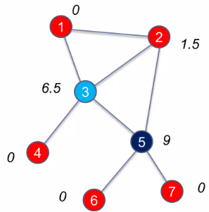
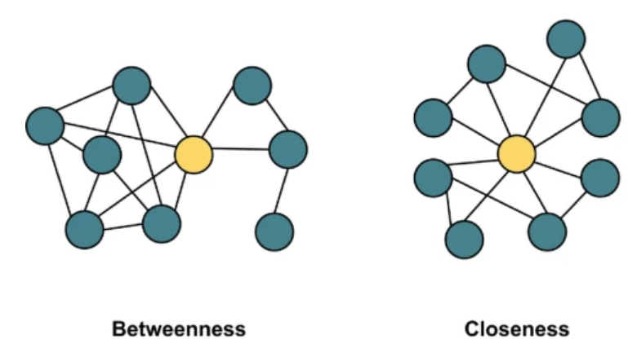
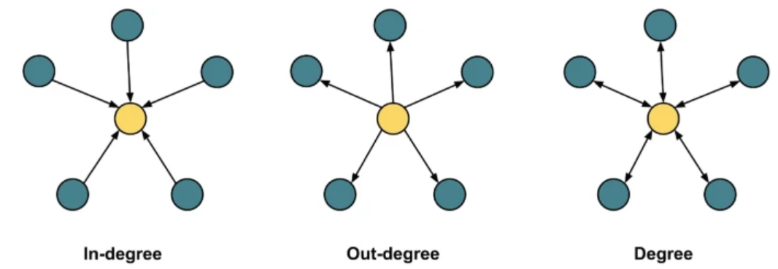

Slide 11
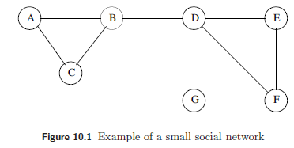
Social Networks as Graphs
Social networks are naturally modeled as graphs, which we sometimes refer to as a social graph. The entities are the nodes, and an edge connects two nodes if the nodes are related by the relationship that characterizes the network.
If there is a degree associated with the relationship, this degree is represented by labeling the edges. Often, social graphs are undirected, as for the Facebook friends graph.
But they can be directed graphs, as for example the graphs of followers on Twitter or Google+.
Figure 10.1 is an example of a tiny social network. The entities are the nodes A through G. The relationship, which we might think of as “friends,” is represented by the edges. For instance, B is friends with A, C, and D.

Slide 12
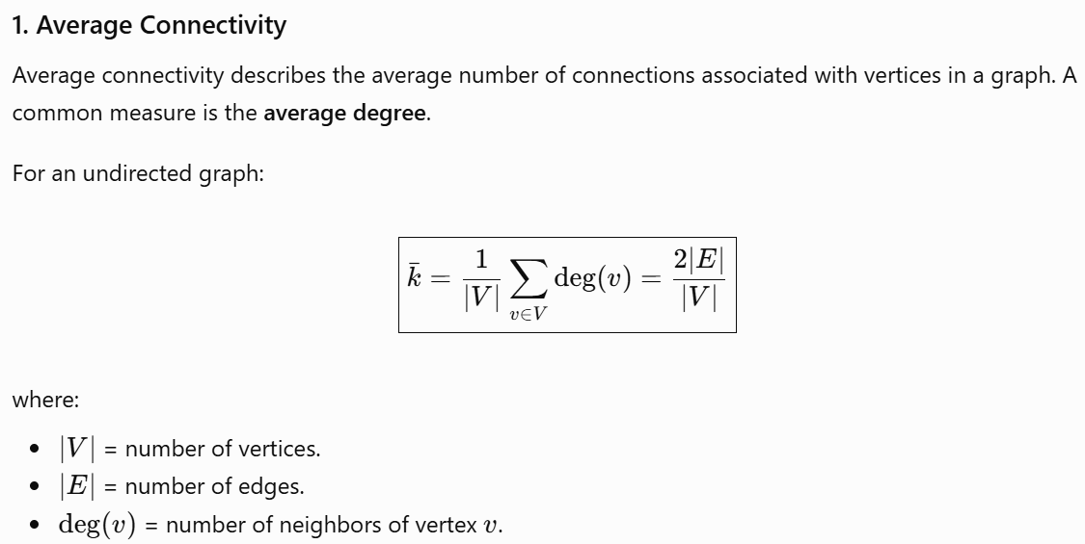
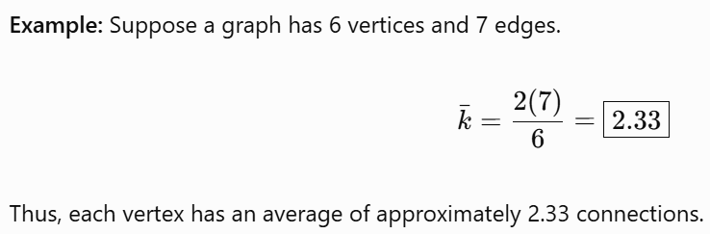
Social Networks as Graphs

Slide 13
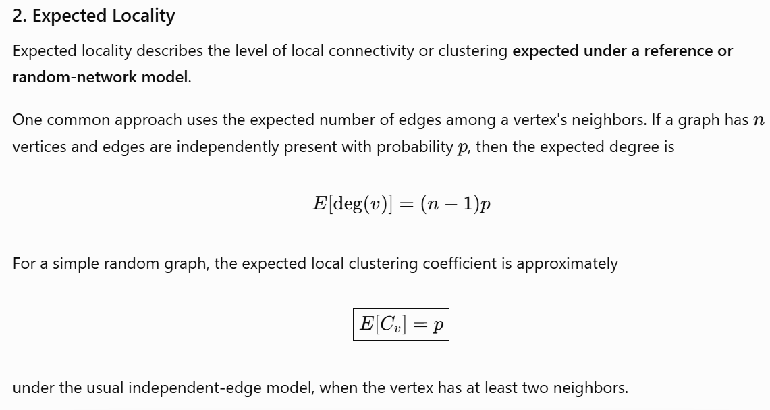
Social Networks as Graphs

Slide 14
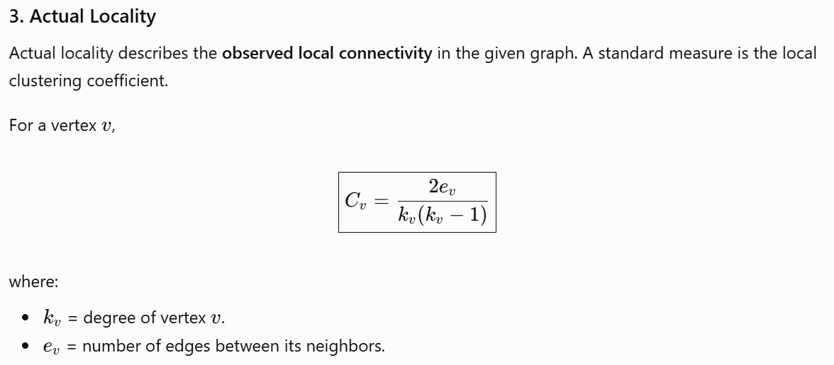
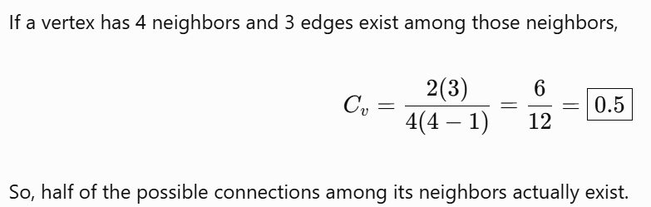
Social Networks as Graphs

Slide 15
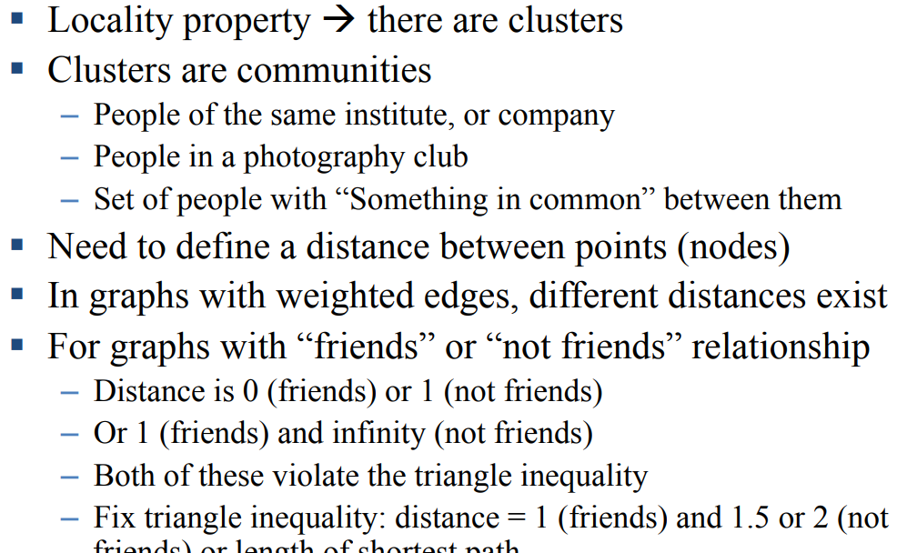
Clustering of Social-Network Graphs
Clustering of the graph is considered as a way to identify communities. Clustering of graphs involves the following steps:
1. Distance Measures for Social-Network Graphs

Slide 16
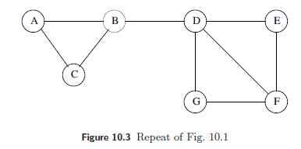
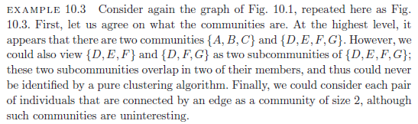
2. Applying Standard Clustering Methods
Hierarchical clustering of a social-network graph starts by combining some two nodes that are connected by an edge. Successively, edges that are not between two nodes of the same cluster would be chosen randomly to combine the clusters to which their two nodes belong. The choices would be random, because all distances represented by an edge are the same.
EXAMPLE:
The problem with hierarchical clustering of a graph like that of Fig. 10.3 is that at some point we are likely to chose to combine B and D, even though they surely belong in different clusters. The reason we are likely to combine B and D is that D, and any cluster containing it, is as close to B and any cluster containing it, as A and C are to B. There is even a 1/9 probability that the first thing we do is to combine B and D into one cluster.

Slide 17
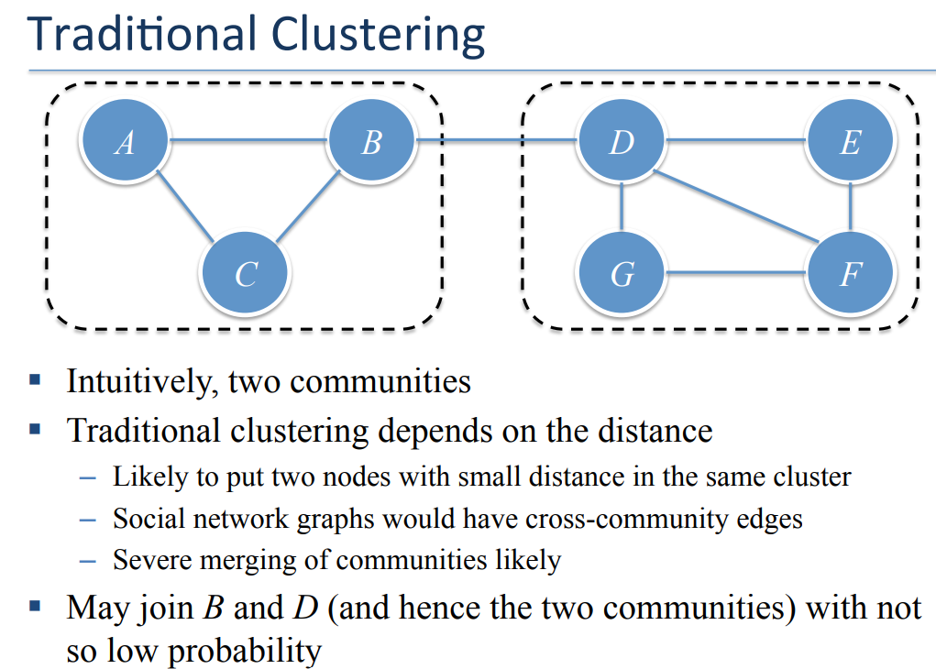

Slide 18
3. Betweenness:
Since there are problems with standard clustering methods, several specialized clustering techniques have been developed to find communities in social networks. The simplest one is based on finding the edges that are least likely to be inside the community.
Define the betweenness of an edge (a, b) to be the number of pairs of nodes x and y such that the edge (a, b) lies on the shortest path between x and y. To be more precise, since there can be several shortest paths between x and y, edge (a, b) is credited with the fraction of those shortest paths that include the edge (a, b). As in golf, a high score is bad. It suggests that the edge (a, b) runs between two different communities; that is, a and b do not belong to the same community

Slide 19
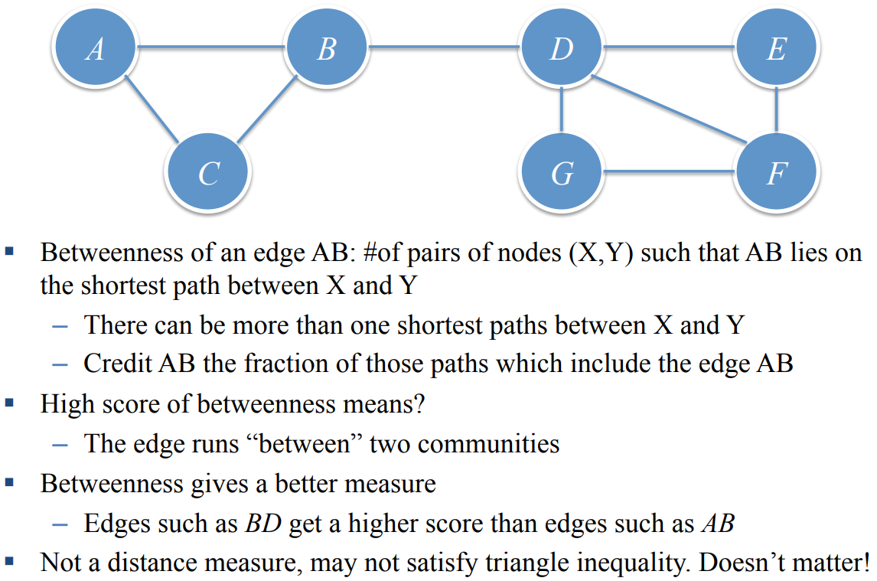
Betweenness:

Slide 20
4. The Girvan-Newman Algorithm:
In order to exploit the betweenness of edges, we need to calculate the number of shortest paths going through each edge. We shall describe a method called the Girvan-Newman (GN) Algorithm, which visits each node X once and computes the number of shortest paths from X to each of the other nodes that go through each of the edges. The algorithm begins by performing a breadth-first search (BFS) of the graph, starting at the node X. Note that the level of each node in the BFS presentation is the length of the shortest path from X to that node. Thus, the edges that go between nodes at the same level can never be part of a shortest path from X.
Edges between levels are called DAG edges (“DAG” stands for directed, acyclic graph). Each DAG edge will be part of at least one shortest path from root X. If there is a DAG edge (Y, Z), where Y is at the level above Z (i.e., closer to the root), then we shall call Y a parent of Z and Z a child of Y, although parents are not necessarily unique in a DAG as they would be in a tree.

Slide 21
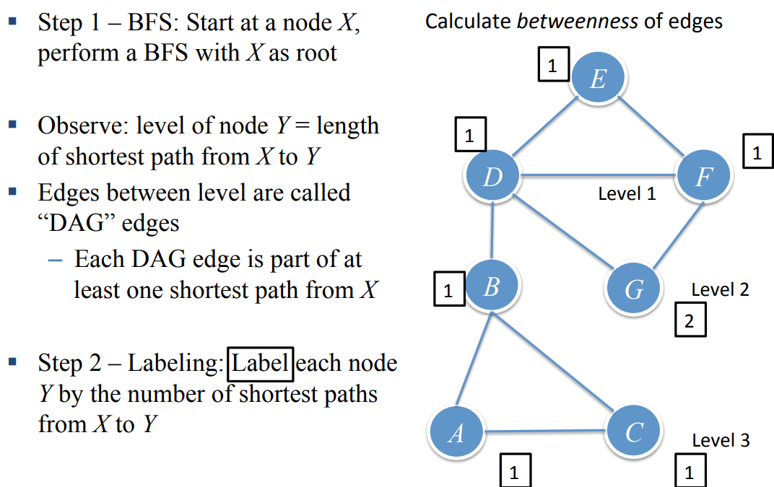
Girvan Newman Algorithm
A directed acyclic graph (DAG) is a graph with nodes connected by directed edges that don't form closed loops

Slide 22
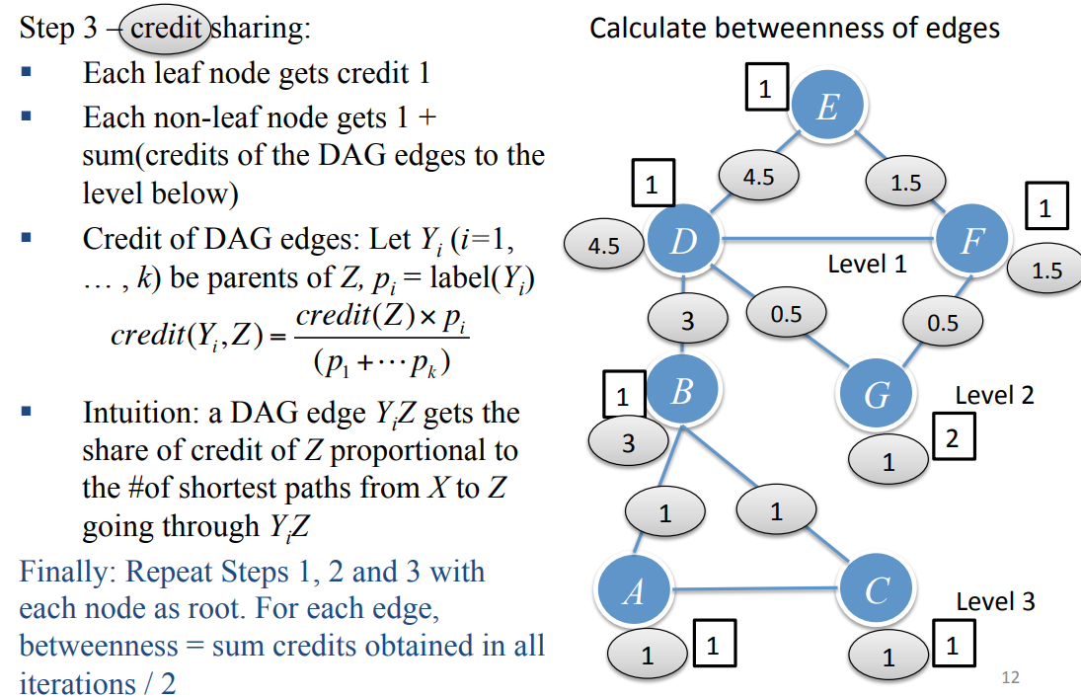

Slide 23
Girvan Newman Algorithm
Construct an undirected graph representing the network.
Run BFS from every vertex to find shortest paths to all other vertices.
Calculate edge betweenness centrality based on the shortest paths.
Remove the edge with the highest betweenness centrality.
Recalculate betweenness because removing an edge can change shortest paths.
Repeat until the desired communities are formed.

Slide 24
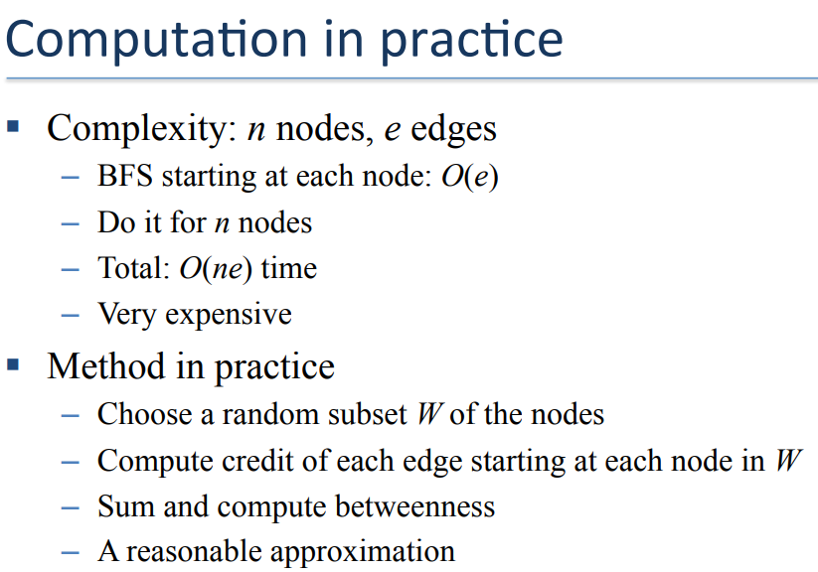

Slide 25
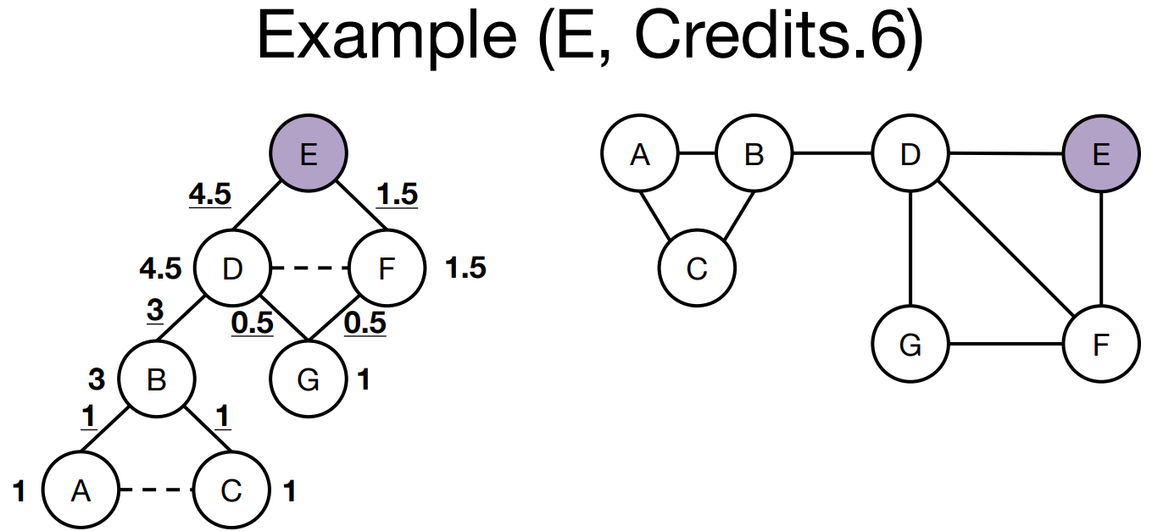
Example: Find Betweenness of edges using Girvan-Newman algorithm. Generate communities of SNG using betweenness.

Slide 26
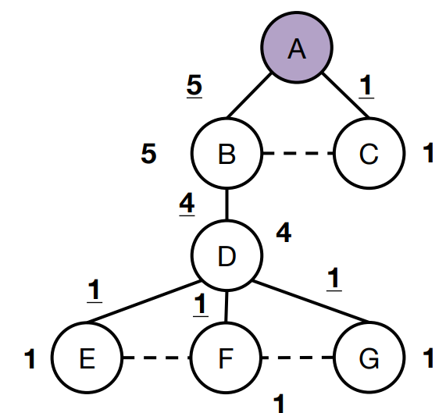
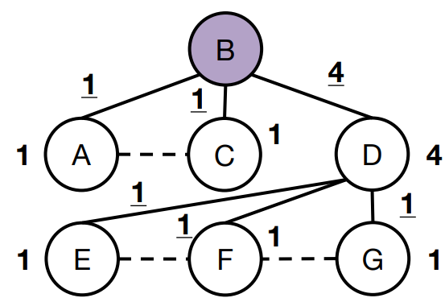

Slide 27
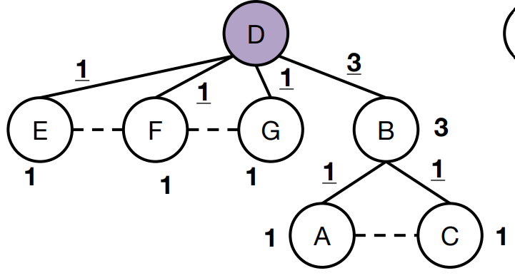
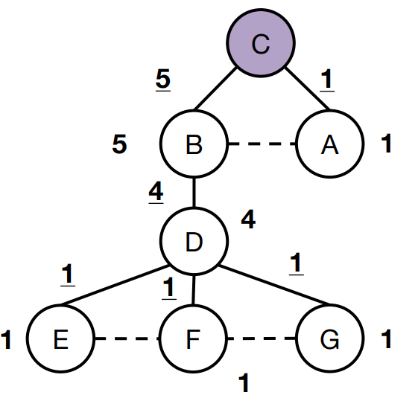

Slide 28
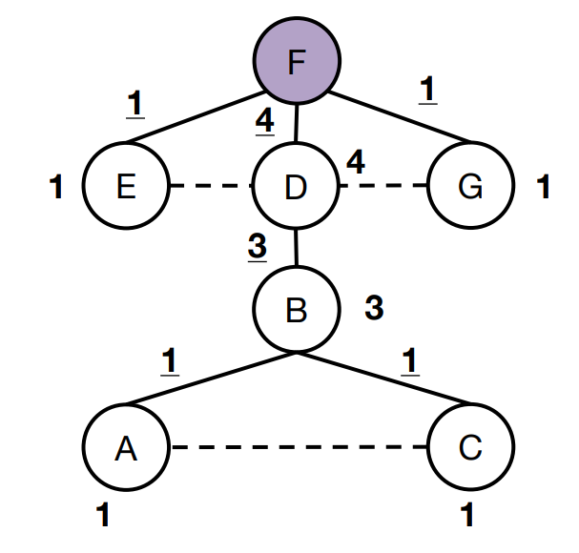
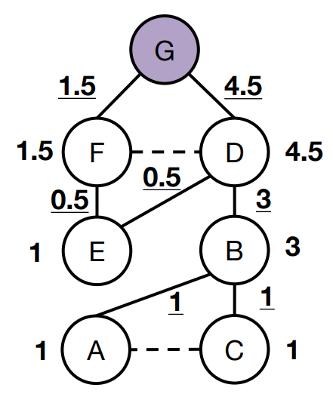

Slide 29
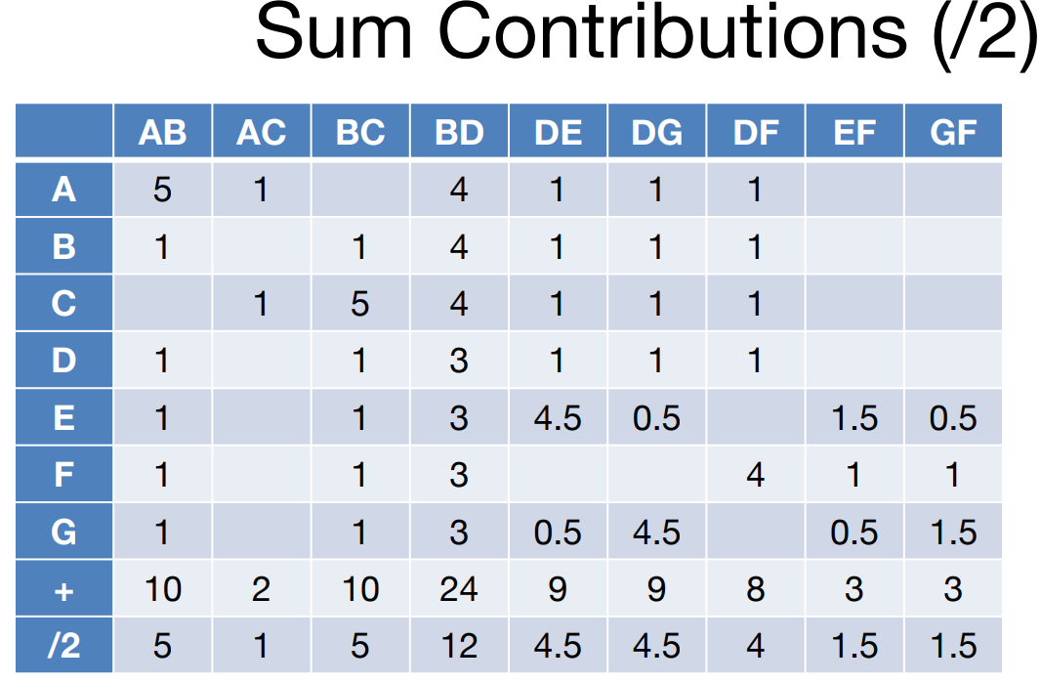
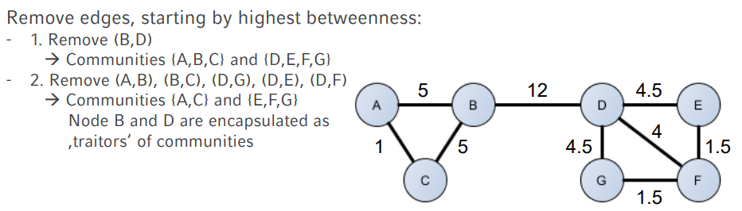

Slide 30
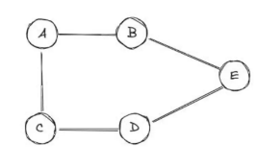
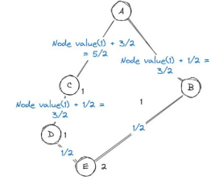
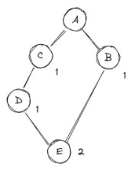
Example: Find community detection for given graph

Slide 31
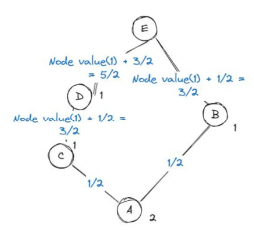
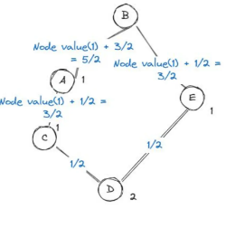

Slide 32
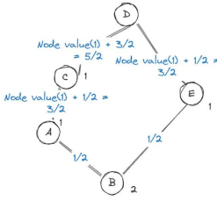
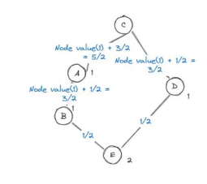

Slide 33
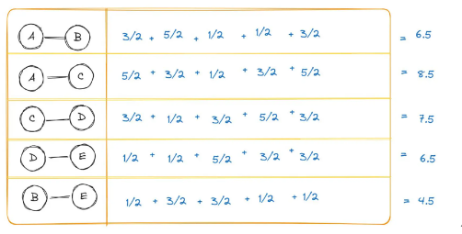
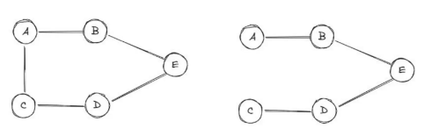

Slide 34
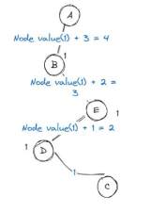
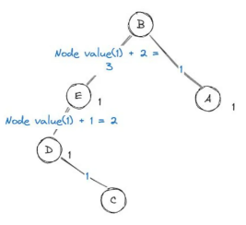
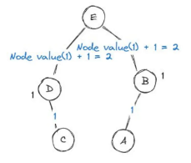
IInd- iteration

Slide 35
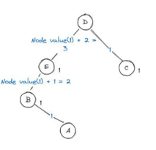
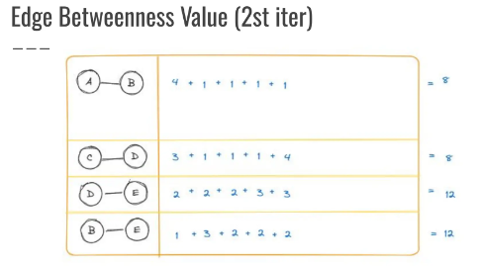
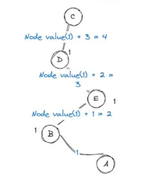
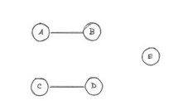

Slide 36
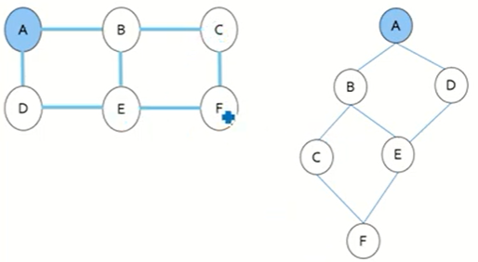
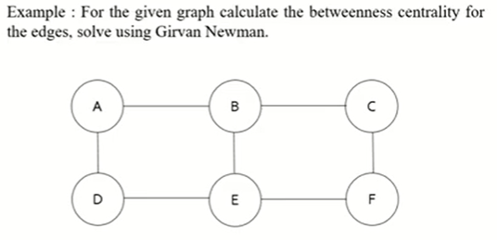
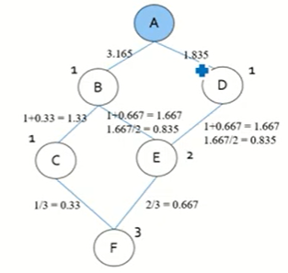
Example:

Slide 37
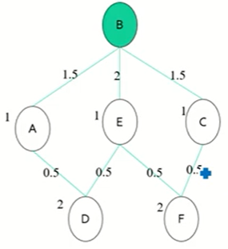
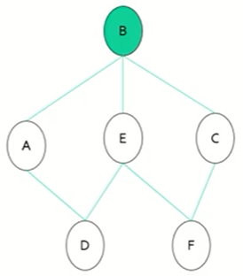
Example: cont…..

Slide 38
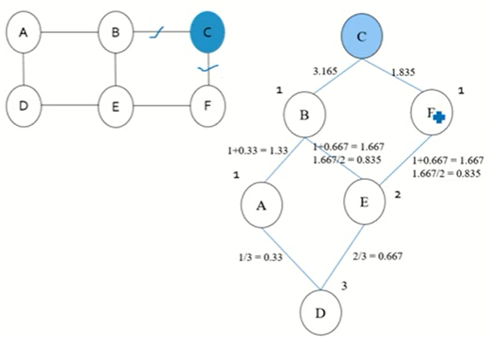
Example Node C as root

Slide 39

Example

Slide 40


Slide 41


Slide 42




Slide 43


Slide 44


Slide 45


